Slide 1

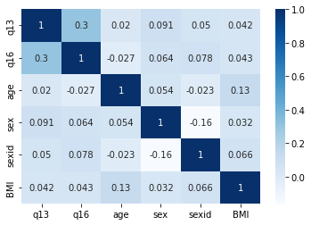

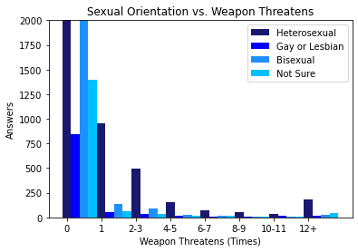
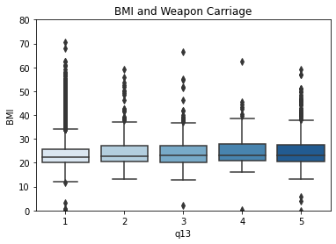
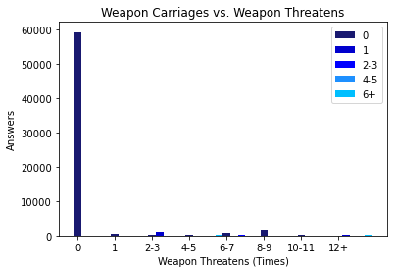
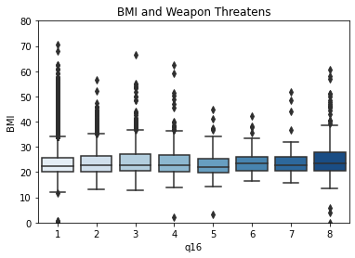








Relationships Between Bringing a Weapon to School and Threatening People
CSCI/ISAT B104
Spring 2023
Authors:
Keaton Laborde and Noah Kohler
University of South Carolina Beaufort, Department of Computational Sciences
Background
Research Questions and Hypothesis
Results Continued
YRBSS
The YRBS(Youth Risk Behavior Surveillance System) is organized by the CDC and has been conducted every two years since 1991. As of 2019, the data set we will be using for this project, there are 89 questions on the questionnaire covering demographics, drug use, sexual activity, violent activities, and health mannerisms.
The overall question is “What is the relationship between students bring a weapon to school and threatening or using their weapon based on them getting bullied.
H0: There IS NOT a correlation between being threatened with a weapon on school property and the victim bring one to school property.
H1: There IS a correlation between being threatened with a weapon on school property and the victim bringing one to school property.
Abstract
The YRBSS (Youth Risk Behavioral Surveillance System) is a questionnaire developed by the CDC beginning in 1991 that analyzes different risk factors that face middle and high school students in the United States. The survey covers a broad spectrum of questions relating to demographics, drug use, sexual activity, physical activity, and violence. The survey is taken anonymously and it’s results are published by the CDC once the next questionnaire has been given out. While the CDC does analyze the responses and report changes between results each year, they do not look at correlations between questions. Our goal with this project was to determine if there was a correlation between individuals who responded that they had been threatened with a weapon on school property and those who responded that they had brought a weapon onto school property in an attempt to see if the problem further accentuates itself due to students feeling they are unable to keep themselves safe. The methodology we utilized was first downloading the YRBSS data in an access file, using SQL to winnow the data down to our two questions and the demographic questions. Python was used for our data analysis and graph creation.
Results
This is a scaled down graph for Body Mass Index due to a student either not understanding the question or putting in the wrong input.
YRBS Data Set 2019
Question 13 asks "During the past 30 days, on how many days did you carry a weapon such as a gun, knife, or club on school property?
Question 16 asks "During the past 12 months, how many times has someone threatened or injured you with a weapon such as a gun, knife, or club on school proper.
This YRBSS data had 200,727 responses but with the file conversion we could only get 65,535 responses
Discussions and Implications
The Body Mass Index graphs help us better understand if a student is overweight. If they are overweight we can infer that they are more likely to be a victim of bullying and lead to self defense with a weapon.
A distinguishable relationship was found between students who were threatened or injured with a weapon on school property and those who carried weapons onto school property.
A minor relationship was found between BMI and being threatened or injured with a weapon on school property.
There is no true correlation between sexual orientation and being threatened or injured with a weapon on school property.
Typically, men are threatened with a weapon on school property more often than females.
There is no true correlation between age and carrying a weapon onto school property.
Methodology
Conclusion
There is a relationship between students who are threatened or injured with a weapon on school property and those who carried a weapon onto school property. Based on our findings students who are threatened at school do not feel comfortable seeking out proper help, or did not receive it when they attempted to get help.

